Slide 1

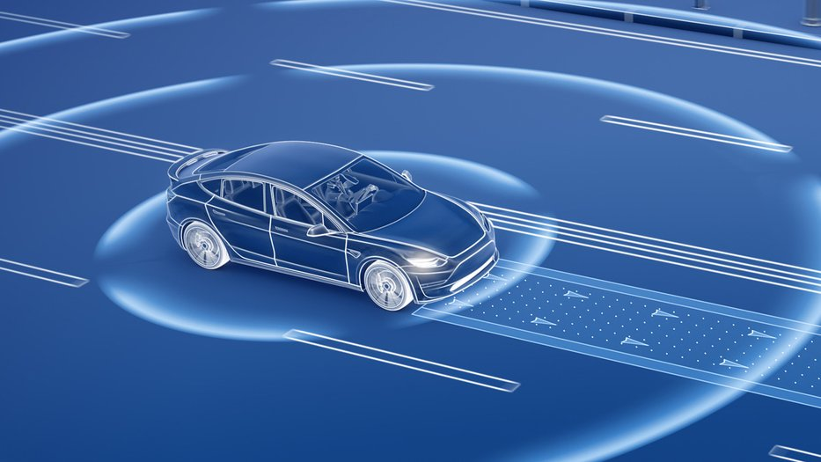
Real Time Wireframe-Based Pothole Detection and Avoidance System
BATCH - 02
Guided by: Dr R G SURESH KUMAR
Presented by: MOHAMED B SIRAJUDDEEN (22TD0053)

Slide 2
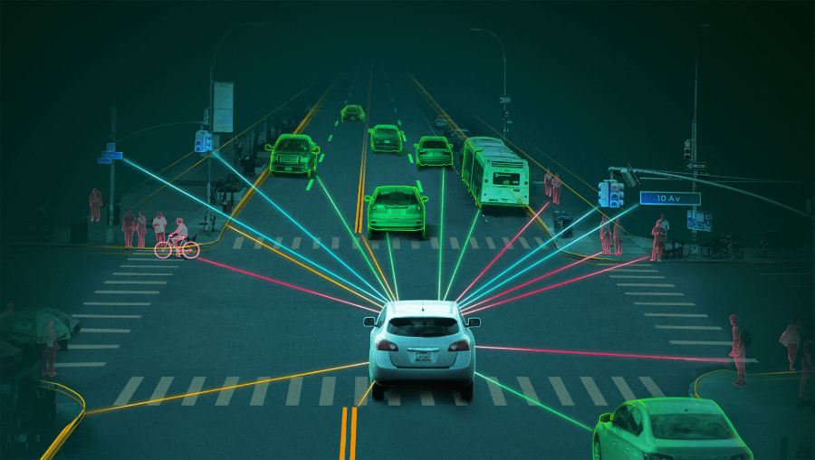

Agenda
01
05
Domain & Sub-Domain
Existing System
02
06
Problem Statement
Existing Architecture
03
07
Objectives
Literature Survey
08
04
Introduction
Conclusion

Slide 3


Domain & Sub-Domain
Artificial Intelligence
Encompasses computational models that replicate human cognitive functions such as perception, learning, reasoning, and autonomous decision-making.
Autonomous Vehicles
Focuses on AI-driven perception and control in autonomous vehicles through deep learning, monocular depth estimation, and real-time 3D scene understanding for safe navigation and environment interaction.

Slide 4

Problem Statement
Road surface irregularities such as potholes pose serious threats to vehicle safety, traffic efficiency, and passenger comfort.
However, existing detection systems are limited by two-dimensional analysis, lacking accurate depth and shape information necessary for precise surface evaluation and effective road safety management.

Slide 5

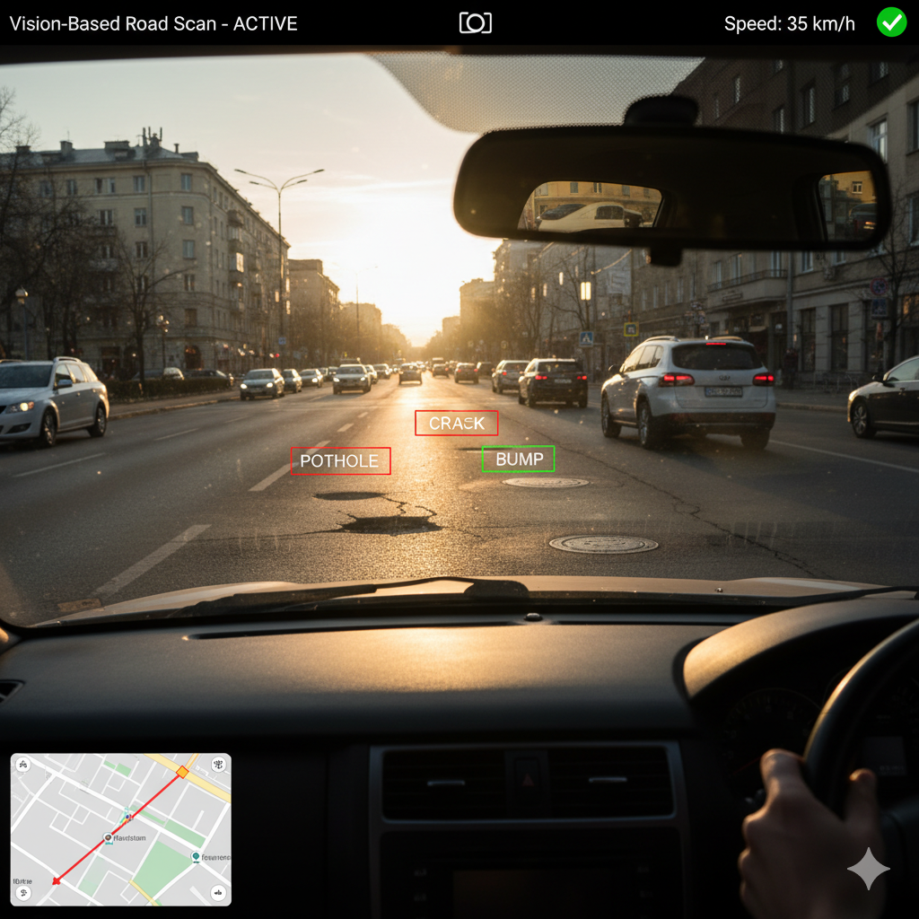
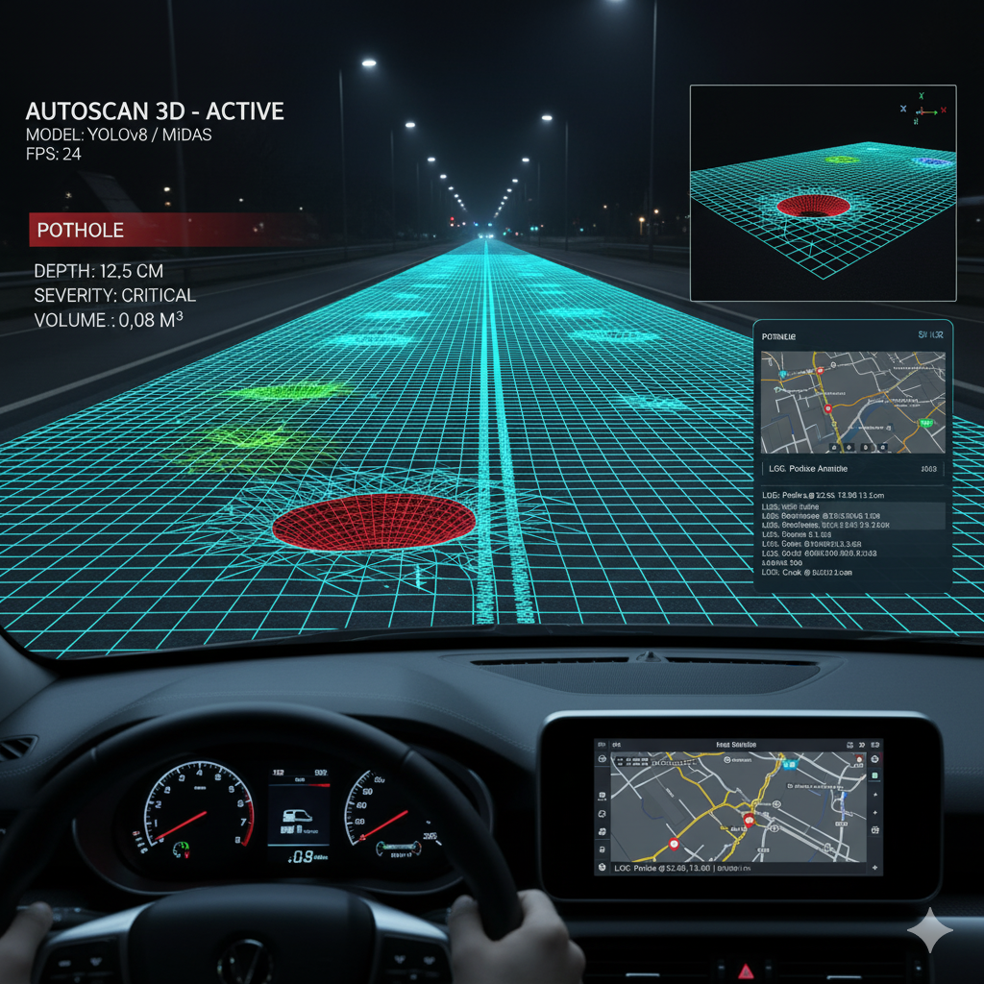
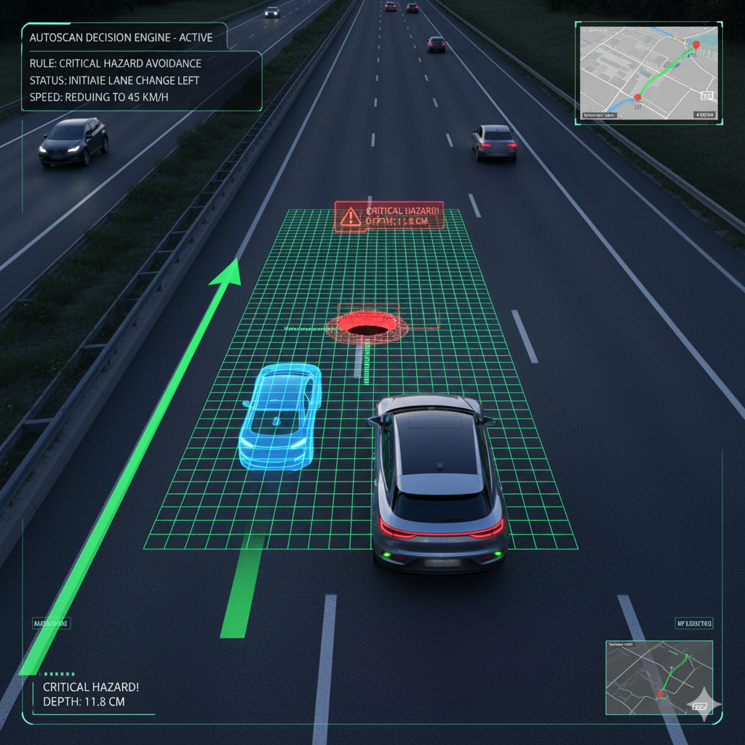
Objectives
Develop a Vision-Based Pothole Detection System
Integrate AI-Based Depth and 3D Analysis
Enable Intelligent Vehicle Decision-Making
Design a real-time pothole and road anomaly detection system using a monocular camera, eliminating dependence on costly sensors like LiDAR or stereo vision.
Employ YOLOv8 for object detection and MiDaS + Open3D for depth estimation and 3D wireframe reconstruction, enabling accurate analysis of road surface geometry.
Implement a rule-based decision engine to guide autonomous vehicle behavior—such as slowing down or avoiding hazards—based on detected anomaly size, depth, and severity.

Slide 6
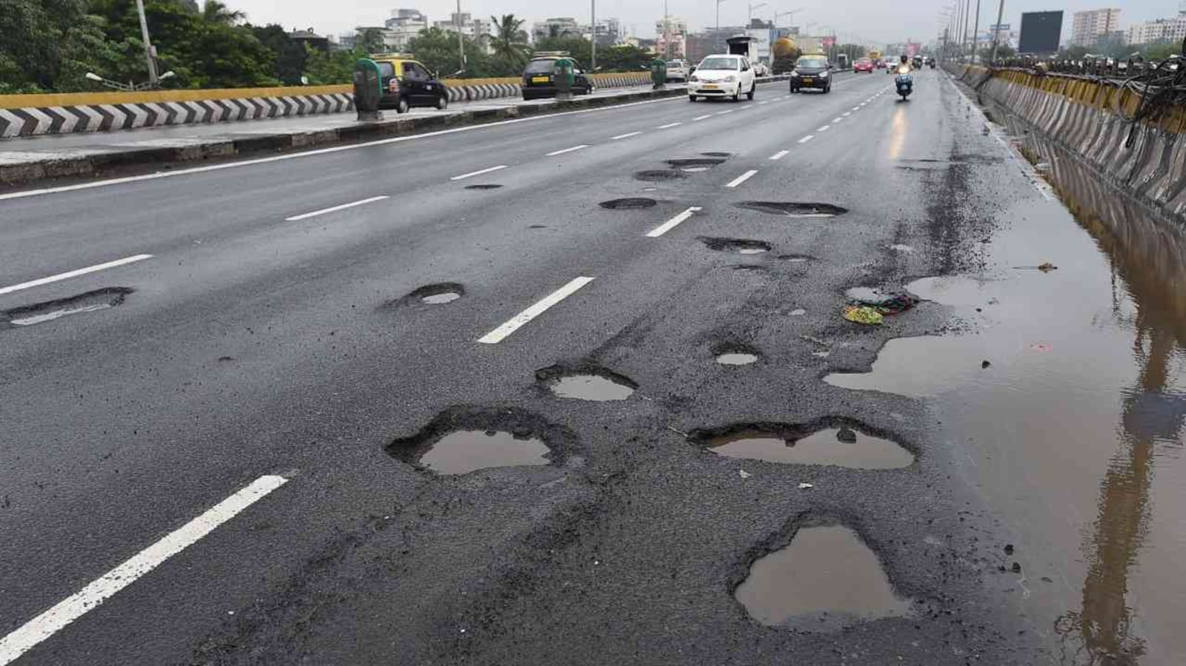
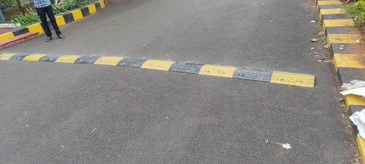
Introduction
Autonomous vehicles (AVs) rely on object detection and navigation systems optimized for structured and well-maintained roads.
In countries like India, road infrastructure is often inconsistent, featuring frequent potholes, speed bumps, and surface deformities.
Standard AV systems struggle to operate reliably in such conditions, impacting safety and ride quality.
Surface anomalies reduce ride comfort and can be significant safety hazards.
Conventional solutions using LiDAR and high-end sensors are expensive and not suitable for mass deployment.
There is a pressing need for a cost-effective, camera-based solution capable of detecting, analyzing, and responding to road surface anomalies in real-time.

Slide 7

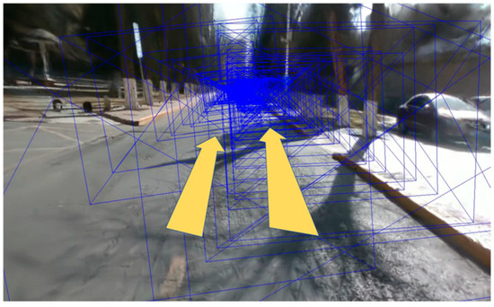
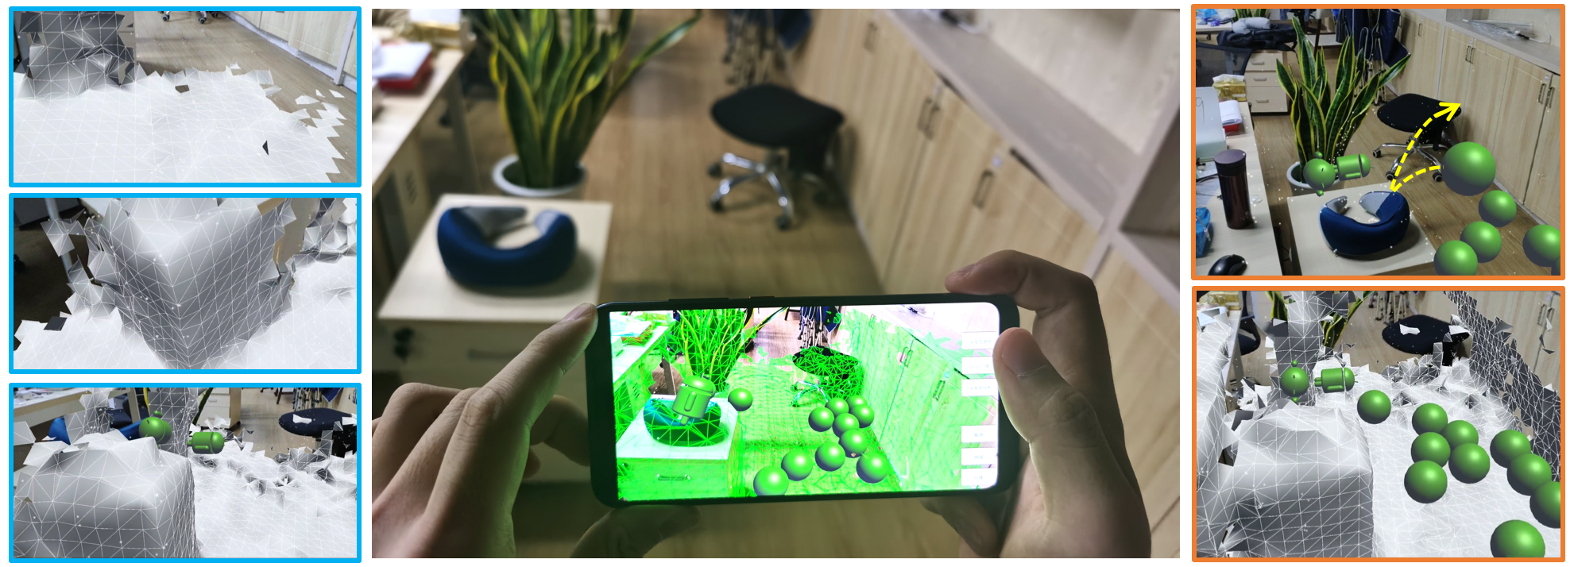
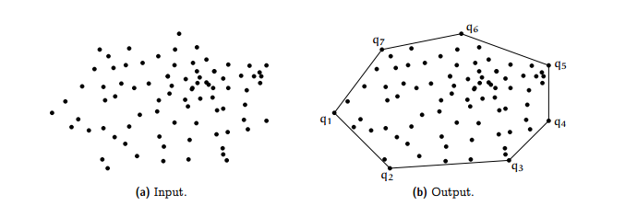
Existing System
YOLO-based detection (YOLOv5, YOLOv8)
LiDAR + Camera fusion for accurate depth
Point cloud and Convex Hull for geometry
Mobile3DRecon – real-time monocular mesh
RoGs – road-specific Gaussian surfel reconstruction

Slide 8
Existing Architecture

Slide 9
Literature Survey
Paper | Technology | Conclusion
Enhancing Pothole Detection and Characterization: Integrated Segmentation and Depth Estimation in Road Anomaly Systems - 2025 | YOLOv8‑seg + monocular depth integration | Validates method of merging segmentation with depth maps
An Enhanced YOLOv8 Model for Real‑Time and Accurate Pothole Detection and Measurement - 2025 | YOLOv8n‑seg enhanced with DSConv, SimAM, GELU + RGB‑D dataset | Guides improving detection performance
Deep Learning based Pothole Monocular Depth Estimation and Segmentation Using 3D Scanner‑Derived Depth Maps - 2023 | Modified 3DPredicNet for depth estimation and segmentation using DSLR images and ground‑truth 3D scans | Supports feasibility of camera-only depth segmentation

Slide 10
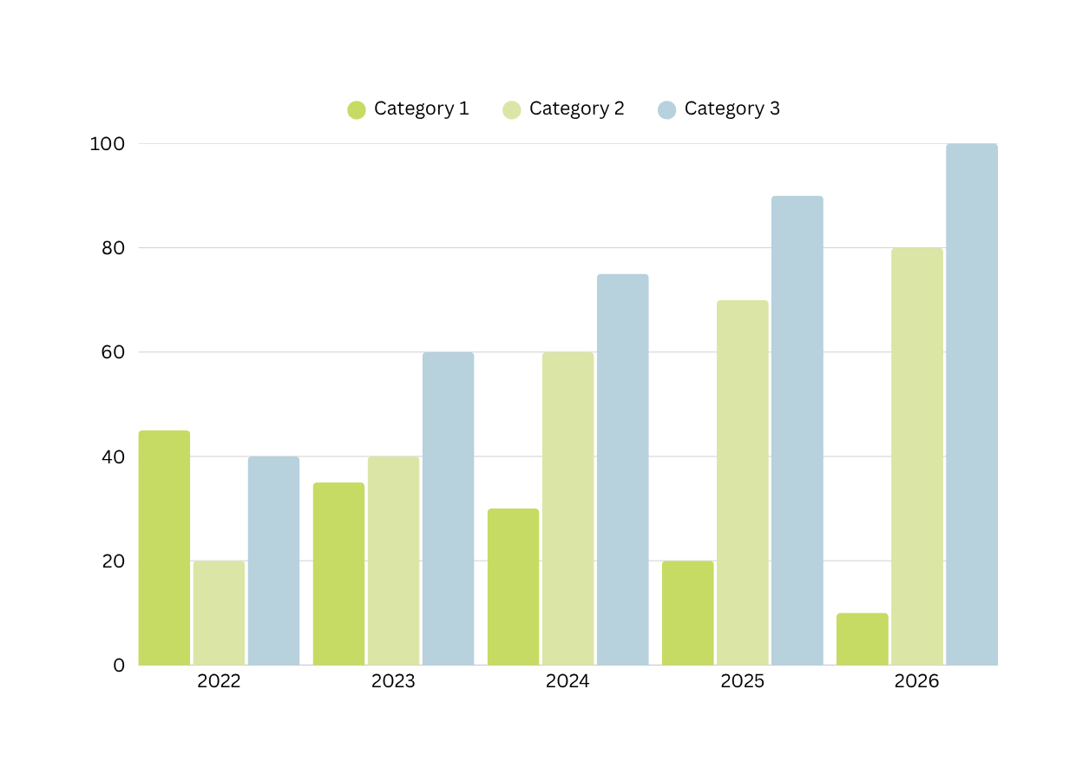
Chart title here
If applicable, use a chart or table to visualize your results or highlight comparisons. Use this section to briefly explain what the results mean.

Slide 11

Conclusion
Reflect on your project's impact and discuss how it relates to your initial goals or problem statement.

Slide 12
Resource Page
Use these in your presentation. Delete or hide this page before presenting.
Fonts
Design Elements / Icons
This presentation template
uses the following free fonts:
TITLES:
Raleway
BODY TEXT:
Inter
You can find these fonts online too.
Colors
#C6DB63
#DBE6A6
#FBFFE7
#B7D1DD
#FFFFFF

